Slide 1
APAC HPC/AI
Competition
GIST NetCS Team

Slide 2
Software Environment
Framework: TensorFlow
Model: ResNet-50
Dataset: ImageNet 2012 (tf-records)
Container: Docker
Distributed training framework: Horovod
Baseline ML Code: TensorFlow benchmarks

Slide 3
Software Environment
Versions:
Nvidia Tensorflow Release 18.09-py2
TensorFlow 1.10.0
Horovod 0.13.10
OpenMPI 3.0.0
CUDA 10.0.130
tf_cnn_benchmarks branch cnn_tf_v1.10_compatible
Used fixed versions because dgx server caused some compatibility issues

Slide 4
Dataset
ImageNet 2012
In form of tf-records as using jpg for training takes longer time to process each image.
Transformed by setDataset.sh.
Transformation process executed in DGX server by build_imagenet_data.pbs connected by setDataset.sh
baseline code from Tensorflow/models.
Preprocessed in ML Code (Distortion, resizing, shift and splits)

Slide 5
PBS Scripts
Two version of scripts:
HorovodTrain.pbs: ImageNet training with horovod and tensorflow for distributed training (Not completed)
DockerSingleTrain.pbs: Simple ML model with one DGX node for faster hyperparameter tuning.

Slide 6
Optimization efforts
Data optimization
changing form to tf-records for faster training
data preprocessing for better accuracy
ML Optimization
Hyperparameter tuning

Slide 7
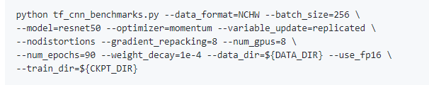
Hyperparameter Tuning
Adjustable parameter
batch size
optimizer
num_epochs
weight_decay

Slide 8
Adjustable parameter
batch size
optimizer: momentum, adagrad, adadelta, adagradDA, RMSprop, Adam
num_epochs: Number of times rotating input dataset
weight_decay: an additional term in the weight update rule that causes the weights to exponentially decay to zero, if no other update is scheduled.

Slide 9
Adjustable parameter
batch size
optimizer: momentum, sgd, rmsprop, Adam
num_epochs: Number of times rotating input dataset
weight_decay: an additional term in the weight update rule that causes the weights to exponentially decay to zero, if no other update is scheduled.

Slide 10
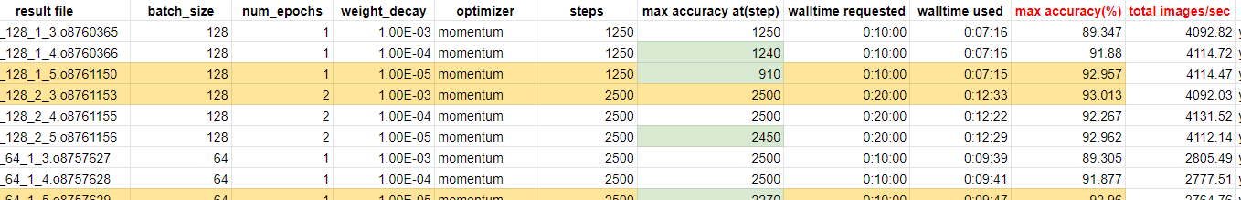
Adjusting parameters
total images/sec is proportional to batch_size.
And weight_decay doesn’t affect that much to total images/sec.
Make batch_size as big as possible before falloff occurs.

Slide 11
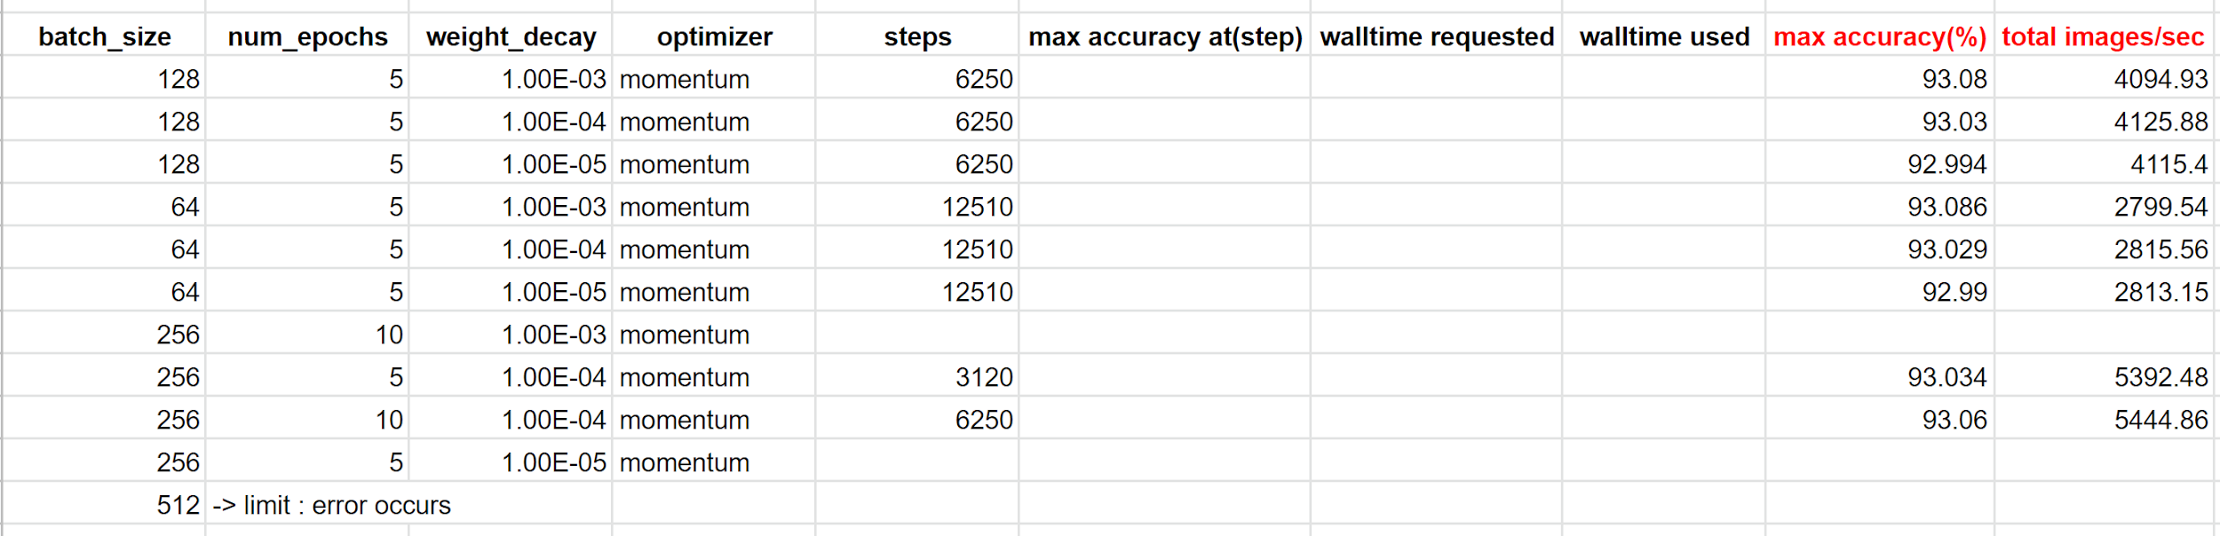
Adjusting parameters
As we expected in the front slide, bigger the batch_size, bigger the total images/sec. But at batch_size 512, limit error occurs.
From this, we can conclude that batch_size 256 is most appropriate

Slide 12
Adjusting parameters
num_epochs is too small -> very underfitted
Increase num_epochs then check the point where overfitting occurs.

Slide 13
Adjusting parameters
batch_size * steps / num_epochs = 160,000 (constant)

Slide 14
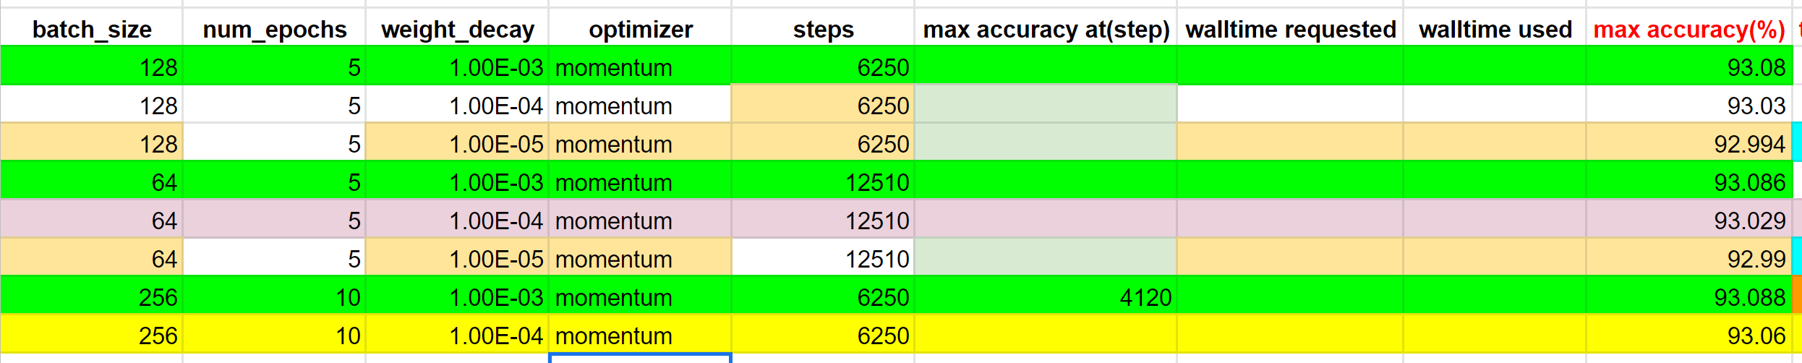
Adjusting parameters
From some experimental results, we can expect that weight_decay with 1e-3 will make maximum accuracy.

Slide 15
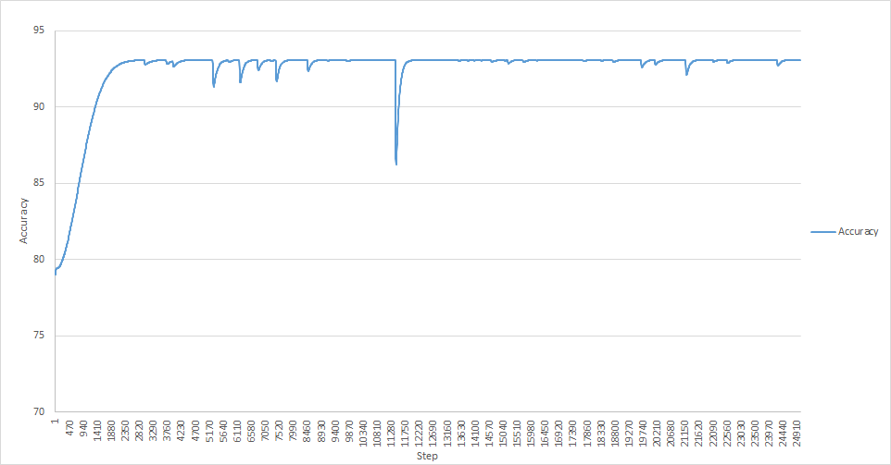
Increasing num_epochs
optimizer : momentum, batchsize : 128,
num_epoch : 20, weight_decay : 1e-3
After this line (Step : 4700), accuracy is almost stable with 93%.
Through front formula, batch_size * steps / num_epochs = 160,000,
we can infer batch_size / num_epochs should be smaller than 32.

Slide 16
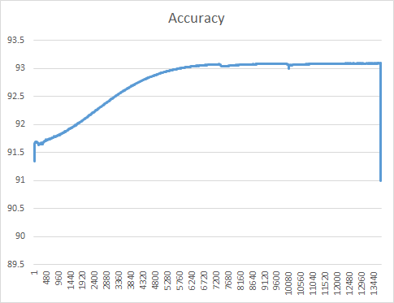
Increasing num_epochs
optimizer : momentum, batchsize : 128,
num_epoch : 20, weight_decay : 1e-4
It has same batchsize and num_epoch, but stability step is different.
At weight_decay 1e-4, stables at step about 7500.
It means, batch_size / num_epochs should be smaller than 24.

Slide 17
Change optimizer
From earlier step, we can conclude,
total images/sec is the biggest one when batchsize is 256.
weight_decay with 1e-3 will make the highest accuracy
with weight_decay 1e-3, batch_size / num_epochs should be smaller than 32.
According to this conclusion, we will change optimizer with below condition.
batchsize : 256, num_epoch : 10, weight_decay : 1e-3

Slide 18
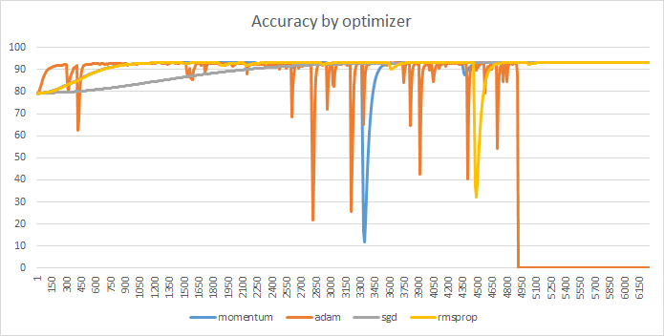
Change optimizer
batchsize : 256, num_epoch : 10, weight_decay : 1e-3

Slide 19
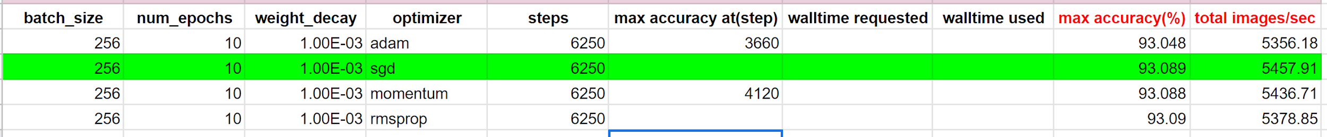
Change optimizer
batchsize : 256, num_epoch : 10, weight_decay : 1e-3

Slide 20
Change optimizer
batchsize : 256, num_epoch : 10, weight_decay : 1e-3
In conclusion, sgd optimizer is the best one for this condition.
Also, sgd optimizer is not reach at maximum in accuracy with 6250 step, increasing the num_epoch is recommended. Then, we can get bigger accuracy.
In addition, by this, we can say our hypothesis : weight_decay 1e-3, batch_size / num_epochs should be smaller than 32 is wrong : it also depends on optimizer.

